Slide 1
Customer Insights: Indian Biscuits

Slide 2
ABSTRACT
The Customer Insights portal is designed for Indian biscuit companies to collect and analyze feedback and sales data, enabling them to improve their products and maintain market competitiveness. This comprehensive feedback system allows companies to effectively brand their products and address customer needs.

Slide 3
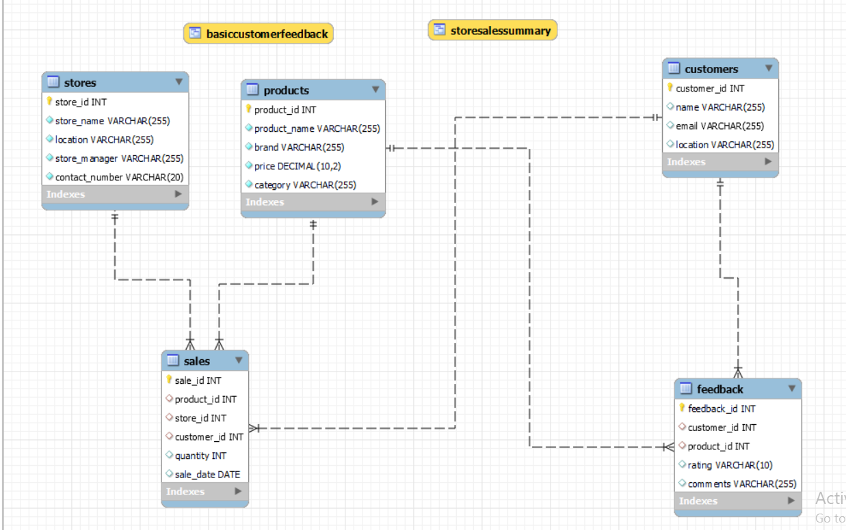
ER - DIAGRAM

Slide 4
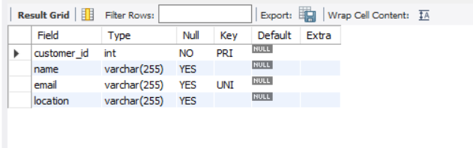
STRUCTURE OF TABLE
Customer Table
Syntax: DESC CUSTOMERS;

Slide 5
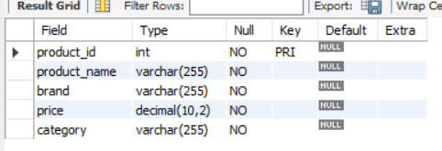
STRUCTURE OF TABLE
Product Table
Syntax: DESC PRODUCTS;

Slide 6
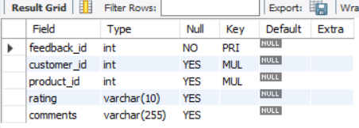
STRUCTURE OF TABLE
Feedback Table
Syntax: DESC FEEDBACK;

Slide 7
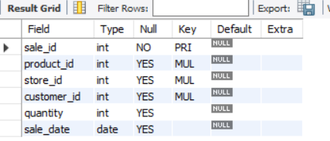
STRUCTURE OF TABLE
Sales Table
Syntax: DESC SALES;

Slide 8
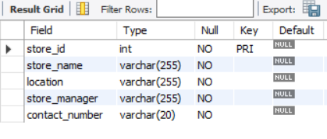
STRUCTURE OF TABLE
Stores Table
Syntax: DESC STORES;

Slide 9
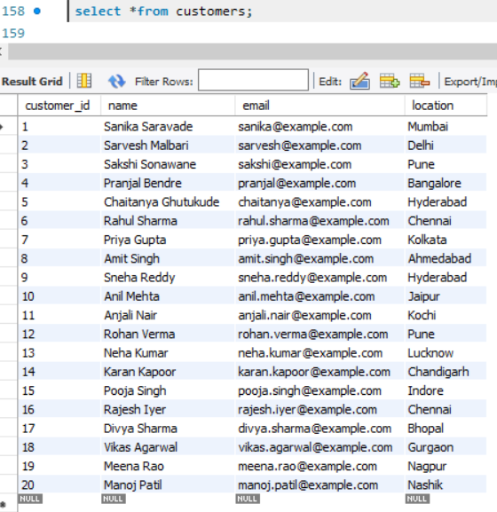
CONTENTS OF TABLE

Slide 10
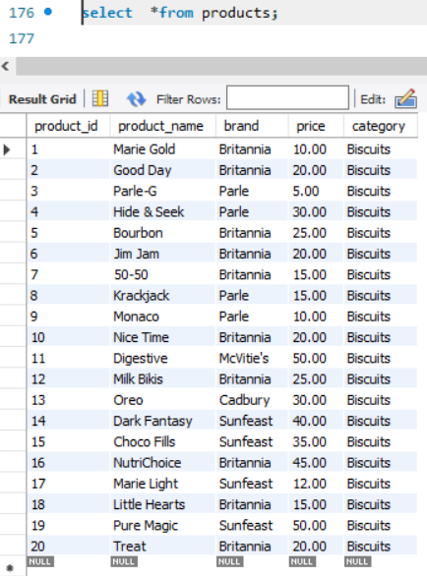
CONTENTS OF TABLE

Slide 11
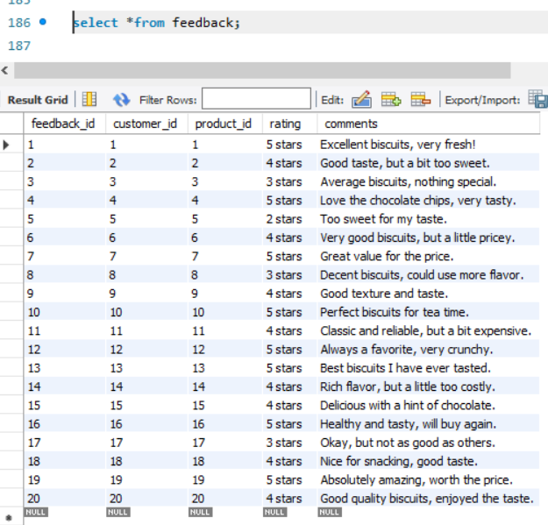
CONTENTS OF TABLE

Slide 12
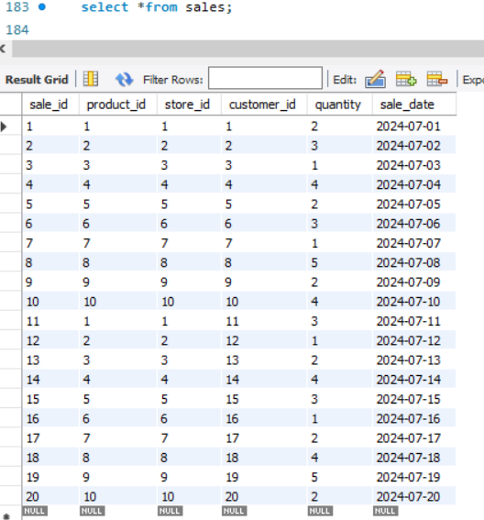
CONTENTS OF TABLE

Slide 13
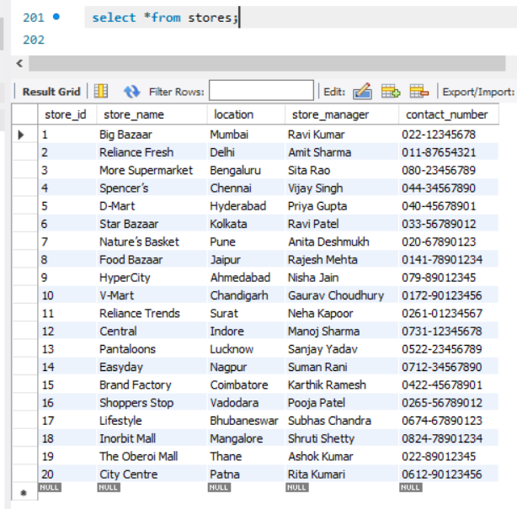
CONTENTS OF TABLE

Slide 14
SUBQUERIES

Slide 15
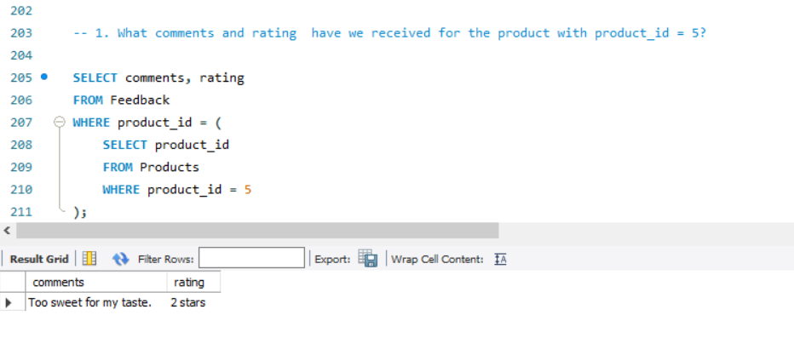
SUBQUERY
1. What comment & rating have we received for the product with product_id = 5?
Syntax:
SELECT comments, ratingFROM Feedback
WHERE product_id =
( SELECT product_id
FROM Products WHERE product_id = 5);

Slide 16
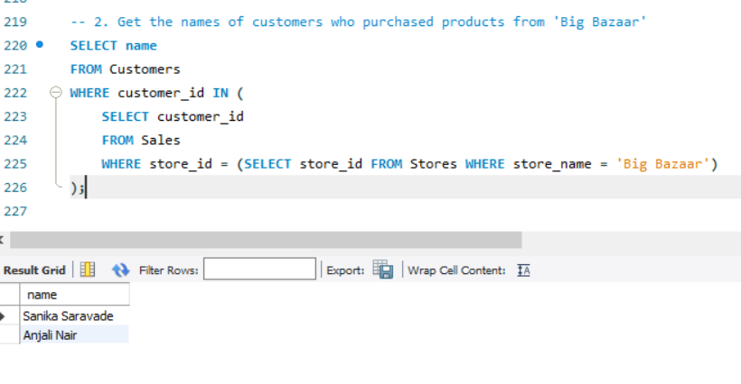
SUBQUERY
2. Get the names of customers who purchased products from ‘Big Bazaar‘
Syntax:
SELECT name
FROM Customers
WHERE customer_id IN
( SELECT customer_id
FROM Sales
WHERE store_id = (SELECT store_id FROM Stores WHERE store_name = ‘Big Bazaar'));

Slide 17
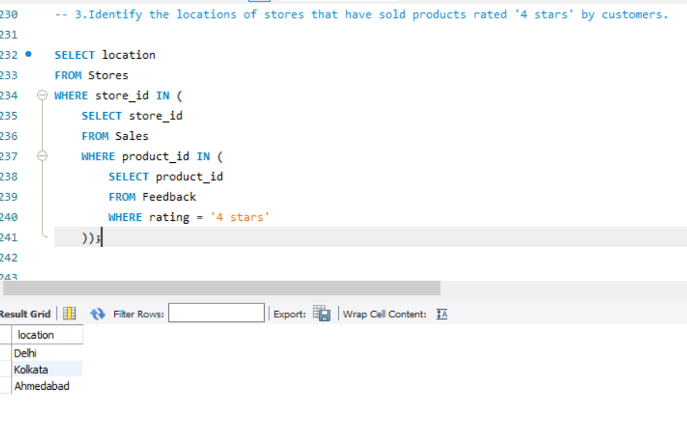
SUBQUERY
3.Identify the locations of stores that have sold products rated ‘4 stars' by customers.
Syntax:
SELECT location
FROM Stores
WHERE store_id IN
( SELECT store_id
FROM Sales
WHERE product_id IN ( SELECT product_id FROM Feedback
WHERE rating = ‘4 stars' ));

Slide 18
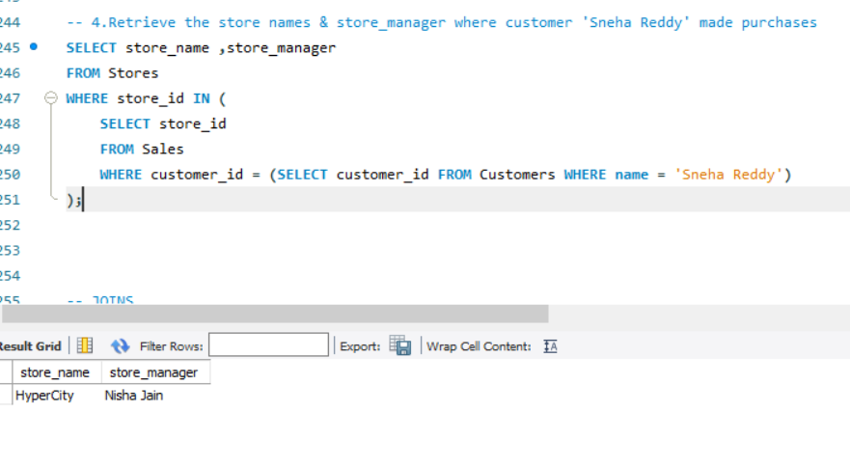
SUBQUERY
4.Retrieve the store names & store manager where customer 'Sneha Reddy' made purchases
Syntax:
SELECT store_name,store_manager
FROM Stores
WHERE store_id IN
( SELECT store_id FROM Sales WHERE customer_id = (SELECT customer_id FROM Customers WHERE name = 'Sneha Reddy'));

Slide 19
JOINS

Slide 20
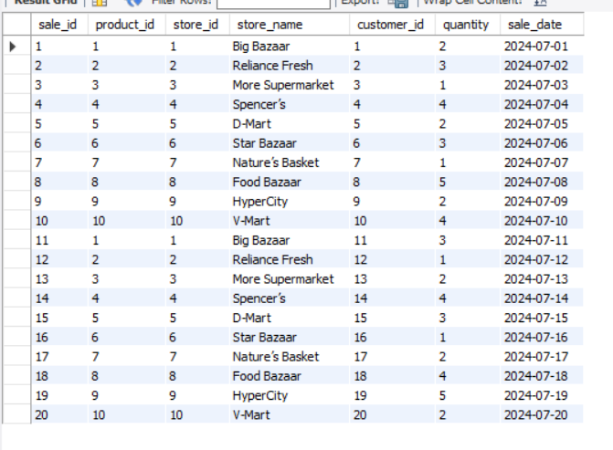
JOINS
1. Retrieve all sales records, including the store details, even if there are no corresponding store details for some sales.
Syntax:
SELECT Sales.sale_id, Sales.product_id, Sales.store_id, Stores.store_name, Sales.customer_id, Sales.quantity, Sales.sale_date
FROM Sales
LEFT JOIN
Stores ON Sales.store_id = Stores.store_id;

Slide 21
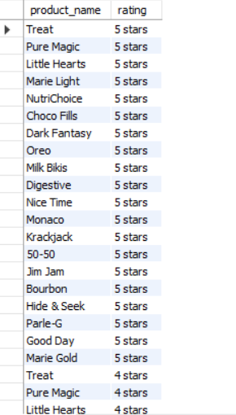
JOINS
2. List all possible combinations of products and feedback ratings:
Syntax:
SELECT Products.product_name, Feedback.rating
FROM Products
CROSS JOIN Feedback;

Slide 22
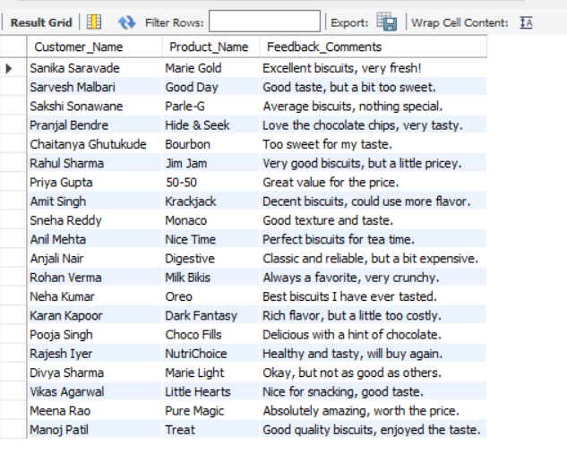
JOINS
-- 3. List of Customers with Their Feedback on Products
Syntax:
SELECT
Customers.name AS Customer_Name, Products.product_name AS Product_Name, Feedback.comments AS Feedback_Comments
FROM Feedback
JOIN
Customers ON Feedback.customer_id = Customers.customer_id
JOIN Products ON Feedback.product_id = Products.product_id;

Slide 23
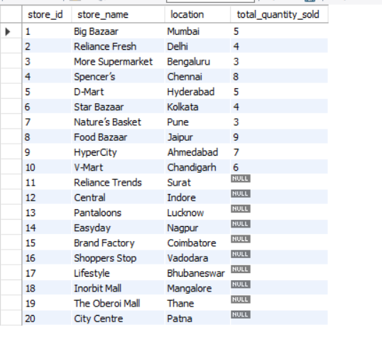
JOINS
4. Show the total quantity sold per store, including stores with no sales.
Syntax:
SELECT
Stores.store_id, Stores.store_name, Stores.location,
SUM(Sales.quantity) AS total_quantity_sold
FROM Sales
RIGHT JOIN Stores ON Sales.store_id = Stores.store_id
GROUP BY Stores.store_id, Stores.store_name, Stores.location;

Slide 24
VIEWS

Slide 25
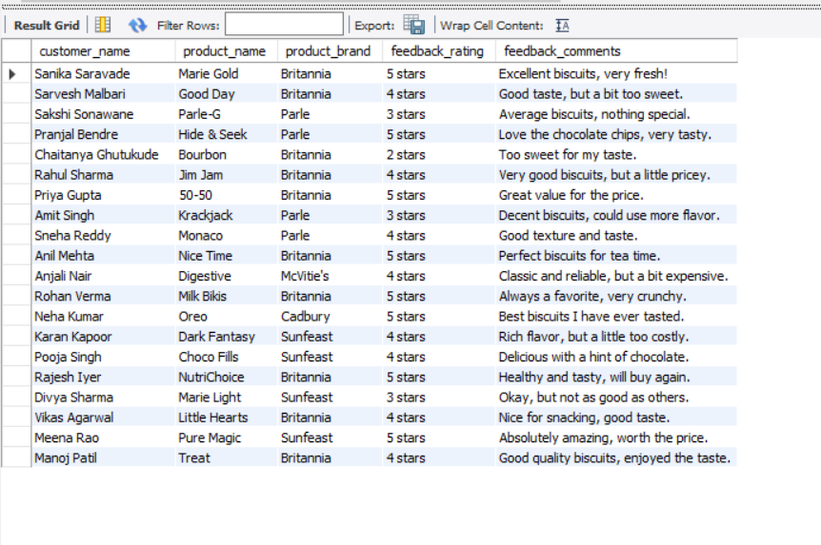
VIEWS
CREATE VIEW BasicCustomerFeedback AS
SELECT c.name AS customer_name, p.product_name, p.brand
AS product_brand,
f.rating
AS feedback_rating,
f.comments
AS feedback_comments
FROM Feedback f
JOIN Customers c
ON f.customer_id = c.customer_id JOIN Products p ON f.product_id = p.product_id;

Slide 26
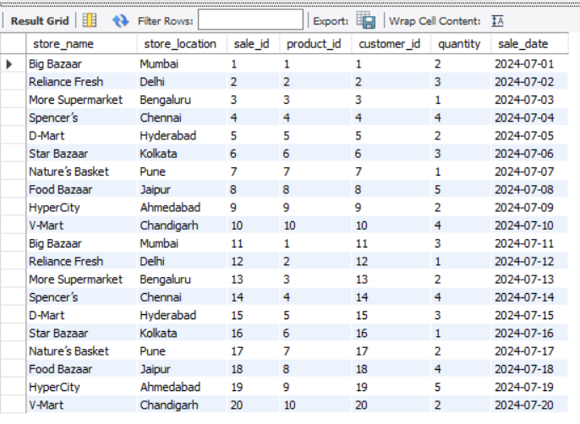
VIEWS
CREATE VIEW
StoreSalesSummary AS
SELECT s.store_name, s.location
AS store_location, sal.sale_id, sal.product_id, sal.customer_id, sal.quantity, sal.sale_date
FROM Sales sal
JOIN Stores s ON sal.store_id = s.store_id;

Slide 27
Thank You

